Slide 1

INSTAGRAM
USER
ENGAGEMENT
Himanshu Goswami
14. 09. 2025

Slide 2
Table of Contents
About Instagram
Problem Statement
Data Overview
Database Schema
Methodology
What Drives True User Engagement?
A Healthy & Active Community
A Mature Platform with Healthy Growth
Identifying Our Top Content Themes
Targeting True Influence
Campaign Strategy
Conclusion

Slide 3
About Instagram
Launched in 2010 and acquired by Meta in 2012, Instagram has evolved from a simple photo-sharing app into a crown jewel of Meta's digital portfolio. By 2025, it stands as a global advertising powerhouse and a primary engine for the creator economy and social commerce.
Its strategic imperative in recent years has been the aggressive expansion into short-form video with 'Reels' to compete directly with platforms like TikTok.

Slide 4
Problem Statement
You are hired as a data analyst at Meta and asked to collaborate with the Marketing team. Marketing teams want to leverage Instagram's user data to develop targeted marketing strategies that will increase user engagement, retention, and acquisition. Provide insights and recommendations to address the following objectives.

Slide 5
Data Overview
Dataset Schema & Cardinality:
The dataset is comprised of 7 distinct tables.
The analysis covers a cohort of 100 unique users.
2. Aggregate Platform Statistics:
Total Content Generated: 257 posts.
Total User Interactions: 8,782 likes and 7,488 comments.
3. Derived Metric Methodology:
Total Engagement: A user-level metric calculated as: (Total Likes + Total Comments).
Engagement Rate: A performance metric calculated as: (Total Engagements / Number of Posts).

Slide 6
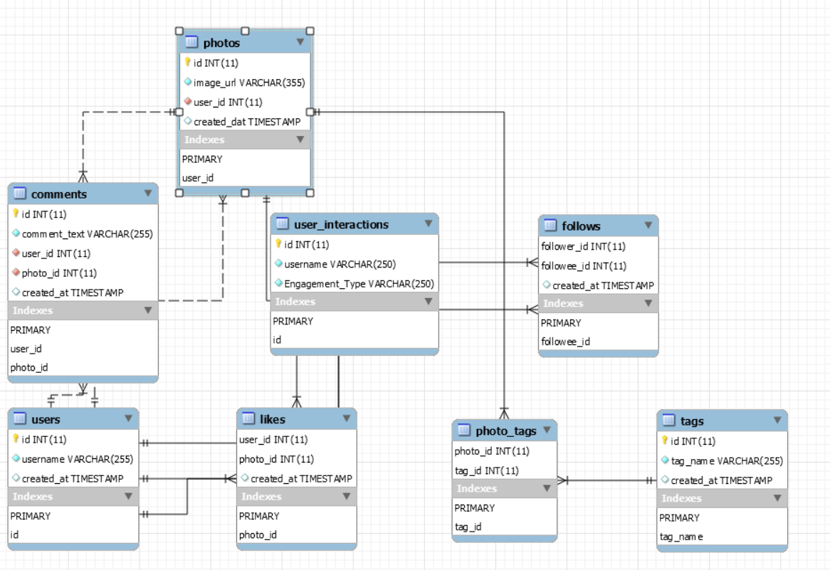
Database Schema

Slide 7
Table Description
users | Stores user account information (id, username, created_at).
photos | Contains uploaded photo data, upload date, and user link.
comments | User comments on photos, with timestamps.
likes | Maps which users liked which photos (many-to-many, with timestamp).
follows | Follower-followee relationship table for users (social network graph).
tags | Stores tags for categorizing photos (unique names, created_at).
photo_tags | Stores tags for categorizing photos (unique names, created_at).
user_interactions | Associates tags to individual photos (many-to-many relationship).

Slide 8
Methodology
My Analytical Workflow:
Data Profiling: Calculate descriptive statistics to establish baseline metrics.
Data Cleansing: Handle nulls and duplicates to ensure data integrity.
Advanced SQL Analysis: Use CTEs, window functions, and aggregates to find key user patterns.
Strategic Recommendations: Develop data-driven strategies to meet business goals.
Actionable Planning: Create clear implementation plans to turn insights into results.

Slide 9
What Drives True User Engagement?
Follower Count Isn't Key Identical follower counts (76) produced vastly different engagement, proving audience size isn't the differentiator.
Quality > Quantity One user's single post (166 score) beat another's five posts (163 score). High-impact content is what matters.
Engagement is Conversation Top users have a healthy balance of likes (appreciation) and comments (discussion), signaling a strong community.

Slide 10
A Healthy & Active Community
41% - Highly Engaged: Our Power Users
This core group represents our most loyal advocates.
Strategy: Empower & Retain.
46% - Moderately Engaged: Our Biggest Opportunity
As the largest segment, they have the highest potential for growth.
Strategy: Nurture & Convert.
13% - Less Engaged: Our At-Risk Segment
A small, contained group that requires proactive measures.
Strategy: Reactivate & Retain.

Slide 11
A Mature Platform with Healthy Growth
65% are "Old Users": Our Established, Loyal Core
Insight: This majority demonstrates strong long-term retention and product stability.
Strategy: Focus on deepening engagement and fostering brand advocacy.
35% are "New Users": Our Engine for Future Growth
Insight: This shows a healthy and ongoing user acquisition pipeline.
Strategy: Optimize the onboarding experience to drive initial activation and long-term conversion.

Slide 12
Identifying Our Top Content Themes
#dreamy is the undisputed top performer, averaging 35.75 likes—a significant outlier.
Aspirational (#beauty, #stunning) and food (#delicious) tags form a reliable, popular core.
The "dreamy" aesthetic, which evokes emotion, has the greatest potential to maximize likes.
Prioritize and build the next content campaign around the #dreamy theme to capitalize on its proven ability to drive the highest engagement.

Slide 13
Targeting True Influence
Prioritize Ad Spend on High-Engagement Influencers:
Data: Users with the same follower count (76) show different engagement (166 vs. 149).
Action: Select influencers based on engagement rate, not just followers, to maximize ROI.
Let Top Performers Inform Ad Creative:
Data: Top user content (e.g., Karley_Bosco) is a proven template for what resonates.
Action: Analyze top user styles to guide our ad creative. Build lookalike audiences from their followers.

Slide 14
Campaign Strategy: Driving Growth Through Personalization & Partnerships
Hyper-Personalization at Scale
Precisely target users based on browsing history and content preferences.
Deploy personalized notifications and emails to boost engagement.
Agile Campaign Optimization
Continuously monitor key metrics (CTR, Conversion, ROI).
Rapidly pause underperforming ads; reallocate budget to top performers.
Strategic Partnerships
Collaborate with influencers who have both high reach and proven engagement.
Pursue co-marketing with synergistic brands to expand our audience.

Slide 15
Conclusion: A Three-Pillar Strategy for Growth
Implement a Segmented User Strategy
Finding: Users fall into 3 clear tiers: High, Moderate, & Low.
Action: Deploy targeted campaigns: Empower advocates, Nurture the majority, and Win-back the at-risk.
Prioritize High-Impact Content: Reels & Hashtags
Finding: Reels and trending hashtags are proven engagement drivers.
Action: Incentivize Reel creation. Build an agile process to monitor and capitalize on trends.
Drive Agile & Personalized Marketing
Finding: Generic campaigns and notifications underperform.
Action: Continuously optimize ad creative to align with trends. Deploy personalized notifications (email/push) to engage users.

Slide 16


